Slide 1
Introduction to Application Development
SDLC & Trends
Instructor: Engr. Andrew Gallemit, CpE, MSIT
College of Computing Studies

Slide 2
Learning Objectives
Define SDLC & its importance
Describe SDLC phases & methodologies
Identify current trends in app development
Apply SDLC knowledge to a case study

Slide 3
What is Application Development?
is the systematic process of designing, creating, testing, and deploying software applications for desktops, mobile devices, or the web to meet specific needs or solve business challenges. It encompasses the entire application lifecycle, from initial planning and requirements gathering to ongoing maintenance and support, and involves various phases like design, coding, testing, and launching.

Slide 4
The Application Development Process
Application development follows a series of phases, often referred to as the Software Development Lifecycle (SDLC):
1. Planning: Identifying the application's purpose, target users, and requirements, as well as outlining the project's goals and scope.
2. Design: Creating blueprints for the application, including user interface (UI) and user experience (UX) design, wireframes, and selecting the necessary tools and technologies.

Slide 5
3. Development/Coding: Building the application by writing the actual code for both the front-end (user-facing parts) and the back-end (server-side logic).
4. Testing: Thoroughly testing the application across various scenarios to find and fix bugs, security vulnerabilities, and usability issues.
5. Deployment: Releasing the application to a production server or marketplace, making it available for end-users.
6. Maintenance: Providing ongoing support, fixing new issues, implementing updates, and managing changes to keep the application functional and secure over time.

Slide 6
Why It Matters
Businesses:
Companies use application development to streamline operations, automate tasks, and improve customer service.
Users:
Applications provide solutions, enhance productivity, and offer convenient access to information and services on various platforms.
Innovation:
It allows for the creation of tailored software solutions that drive innovation and help organizations stay competitive.

Slide 7
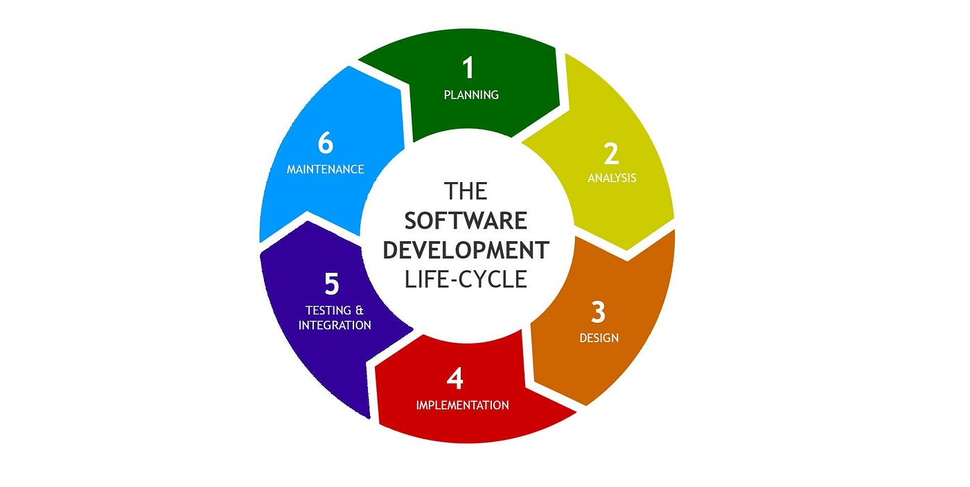
What is SDLC?
Software Development
Life Cycle, is a structured, step-by-step process that teams use to plan, design, develop, test, deploy, and maintain high-quality software systems. It acts as a framework or roadmap for software projects, breaking them into distinct phases with specific goals and deliverables to ensure the software meets stakeholder needs and customer expectations efficiently and cost-effectively.

Slide 8
Phases of SDLC
1. Planning
2. Design
4. Development/Coding
5. Testing
6. Deployment
7. Maintenance

Slide 9
SDLC Methodologies
- Waterfall
- Agile
- Spiral
- Iterative
- V-Model
- DevOps (CI/CD)

Slide 10
Waterfall Model
- Sequential design process
- Advantages: Clear structure
- Limitations: Inflexible to changes
Notes:
Key Characteristics
Sequential Phases:
Work progresses from one phase to the next in a fixed order, like water flowing over a waterfall.
Linear Progress:
The process moves in a single direction, and returning to a previous phase is generally not possible or expected.
Clear Deliverables:
Each phase has a distinct output that serves as the input for the subsequent phase, ensuring a structured workflow.

Slide 11
Agile Model
- Iterative, customer collaboration
- Advantages: Flexible, adaptive
- Limitations: Requires high involvement
Notes:
Key Characteristics
Iterative Development:
Projects are broken down into smaller, manageable parts, with working software delivered after each iteration or sprint.
Incremental Delivery:
Each iteration adds new features to the product, building upon previous work to reach the final customer-desired outcome.
Continuous Feedback:
Regular feedback loops between team members and stakeholders allow for quick adjustments and continuous improvement.
Self-Organizing Teams:
Teams are empowered to make decisions about how to accomplish their work, fostering autonomy and collaboration.

Slide 12
Spiral Model
- Focus is on managing potential risks
- The project progresses through multiple cycles (spirals), with each cycle adding functionality and refining the software
- Clients and stakeholders are actively involved throughout the process
- The iterative nature allows for changes in requirements to be incorporated into subsequent spirals, making it adaptable
Notes:
Key Characteristics
Risk-Driven:
The primary focus is on managing potential risks, making it suitable for large, complex, and high-risk projects.
Iterative & Incremental:
The project progresses through multiple cycles (spirals), with each cycle adding functionality and refining the software.
Customer Involvement:
Clients and stakeholders are actively involved throughout the process, providing feedback at the end of each iteration.
Flexibility:
The iterative nature allows for changes in requirements to be incorporated into subsequent spirals, making it adaptable.

Slide 13
Iterative Model
- Incremental Development
- It is flexible and can adapt to changing requirements or new features that emerge during development
- Customer and stakeholder feedback is incorporated early and often
- Risks can be identified and mitigated in the early stages of each iteration
Notes:
Key Characteristics
Incremental Development:
New features are added in stages, leading to a more complete product with each iteration.
Adaptability:
It is flexible and can adapt to changing requirements or new features that emerge during development.
Early Feedback:
Customer and stakeholder feedback is incorporated early and often, helping to guide the development process.
Risk Reduction:
Risks can be identified and mitigated in the early stages of each iteration, reducing the likelihood of major issues later on.

Slide 14
V-Model
- Sequential Phases
- Verification on the Left
- Validation on the Right
- Parallel Activities
Notes:
How the V-Model Works
Sequential Phases:
Like the Waterfall model, the V-model follows a strict sequential process where each phase must be completed before the next begins.
Verification on the Left:
The left side of the "V" represents the development process, where requirements are broken down and specifications are defined.
Validation on the Right:
The right side of the "V" represents the corresponding testing activities, where the developed components are assembled and tested to ensure they meet the requirements from the left side.
Parallel Activities:
Testing activities are planned in parallel with their corresponding development phases, allowing for early detection and prevention of defects.

Slide 15
DevOps Model
- Collaboration
- Automation
Continuous Improvement
Shared Responsibility
Notes:
Core Principles
Collaboration:
Development and operations teams, along with quality assurance and security, work together as a single, unified team, taking end-to-end responsibility for a product's success.
Automation:
Repetitive tasks in the software delivery process are automated, including coding, building, testing, and deployment, to reduce errors and increase speed.
Continuous Improvement:
The model emphasizes rapid, iterative development and deployment, with continuous feedback loops to quickly identify and resolve issues, allowing for constant evolution of products.
Shared Responsibility:
Everyone involved in the product lifecycle is responsible for its quality, fostering a culture of shared ownership.

Slide 16
Case Study Activity
Scenario: University needs a mobile app for online enrollment.
Question: Which SDLC model would you use and why?

Slide 17
Current Trends in App Development
- Cloud-based development
- Mobile-first, cross-platform
- Low-code / no-code platforms
- AI/ML integration
- Cybersecurity & DevSecOps

Slide 18
Trends in Action
Examples:
- TikTok → AI/ML integration
- Canva → Cloud-based + collaboration
- Microsoft PowerApps → Low-code platform

Slide 19
Group Activity
Research sprint: Find examples of apps applying these trends and share with the class.

Slide 20
Wrap-Up Activity
- Propose a simple app idea
- Select an SDLC model
- Apply one current trend

Slide 21
Reflection Questions
1. Which SDLC model fits your working style? Why?
2. How can trends shape the future of software development?

Slide 22
Thank You
Next session topic
Requirements Analysis, UI/UX

